Slide 1

Introduction to algorithms e-paths/tours, spanning trees, shortest paths
Lecture 10
Thursday, 2 december 2020

Slide 2
Reminder!
Your
coursework project is
due tonight (2 DEC) at
11:59 PM China Time.
You must submit a neatly typed pdf file
Sign and include the coursework submission form

Slide 3
Graph definition
A graph is a mathematical concept.
G=(V,E)
A graph is a collection of Vertices and Edges
Edge
Vertex (vertices)

Slide 4
Degree of a vertex
The degree of a vertex is the number of edges incident to it.
A
Vertex | Degree
A | 3
B | 5
C | 3
D | 3
B
D
C

Slide 5
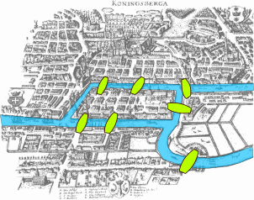
The bridges of KÖnigsberg problem
In the former city of Königsberg, East Prussia (now in Russia), the river Preger had 7 bridges.
PROBLEM:
Can we cross all the
bridges exactly once
and end up
where we started?

Slide 6

Convert the map to a graph
B
C
A
D

Slide 7
Convert the map to a graph
B
C
A
ALTERNATIVE PROBLEM:
Can you draw this graph on paper where you start at one vertex and draw each edge once without lifting your pen?
D

Slide 8
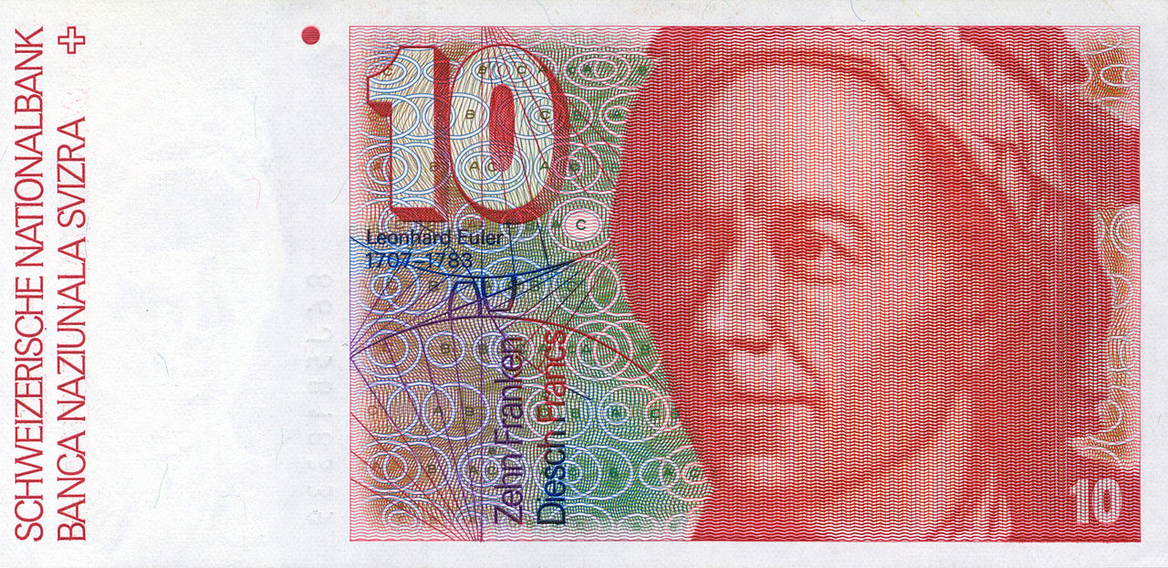
Leonhard euler solved the problem!
In 1736 Leonhard Euler
explained why the problem of
crossing the 7 bridges of
Königsberg is impossible!
Leonhard Euler (1707-1783)
Euler defined a new concept, called a tour.

Slide 9
Eulerian tour
Eulerian tour is a path in a finite graph that
visits every edge only once and
starts and ends at the same vertex.
In an Eulerian tour we are allowed to
revisit vertices.
An Eulerian tour can be drawn with a
continuous stroke of a pen
i.e. No lifting of pen!
No Eulerian tour

Slide 10
existence of Eulerian tour
for each vertex that we enter during the tour via an edge, we must also be able to exit via another edge.
The number of edges entering each
vertex, must be equal to the number of edges exiting that vertex.
the degree of each vertex must be even

Slide 11
existence of Eulerian tour
If a graph has an Eulerian tour then every vertex must be of even degree.
B
NO E-TOUR!
Vertex | Degree
A | 3
B | 3
C | 5
D | 3
C
A
D

Slide 12
example
It has Eulerian Tour
end
start

Slide 13
example
end
It has Eulerian Tour
start

Slide 14
Eulerian path
In an Eulerian Tour, we have the strict condition of covering each edge ONLY ONCE!
and, MUST start and finish at the same vertex.
The degree of start and end vertices must be odd
Can only have two vertices with odd degree
In an Eulerian Path, we still have the strict condition of covering each edge ONLY ONCE!
but, CAN start and finish at different vertices.
deg(A)=even
A
A
deg(D)=odd
deg(B)=odd
D
B
D
B
Stuck!!
C
C

Slide 15
Eulerian path example
start
A
B
end
C
E
D

Slide 16
spanning tree
TREE: is a graph with no cycles
SPANNING TREE: is a tree obtained from a graph that connects all the vertices
n vertices
A
A
A
A
3 vertices
C
C
C
C
2 edges
B
B
B
B
graph
spanning tree
spanning tree
spanning tree
n-1 edges
4 vertices
A
B
A
B
A
B
A
B
A
B
3 edges
C
D
C
D
C
D
C
D
C
D

Slide 17


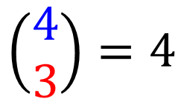
How many spanning trees a graph can have?
A
B
A
B
A
B
A
B
A
B
C
D
C
D
C
D
C
D
C
D
$$\left(\begin{matrix}4 \\ 3\end{matrix}\right)=4$$
$$\left|V\right|=4, \left|E\right|=4, \left|E_{s}\right|=3$$
$$⇒$$
spanning trees

Slide 18


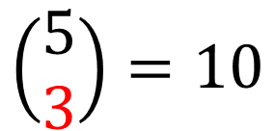
How many spanning trees a graph can have?
A
B
A
B
A
B
A
B
A
B
8
??
C
D
C
D
C
D
C
D
C
D
A
B
A
B
A
B
A
B
C
D
C
D
C
D
C
D
$$\left(\begin{matrix}5 \\ 3\end{matrix}\right)=10$$
$$\left|V\right|=4, \left|E\right|=5, \left|E_{s}\right|=3$$
$$⇒$$
spanning trees
A
B
A
B
C
D
C
D

Slide 19
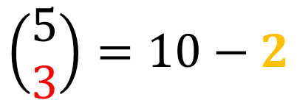
How many spanning trees a graph can have?
A
B
A
B
A
B
A
B
A
B
8
??
C
D
C
D
C
D
C
D
C
D
A
B
A
B
A
B
A
B
C
D
C
D
C
D
C
D
$$\left(\begin{matrix}5 \\ 3\end{matrix}\right)=10−2$$
$$\left|V\right|=4, \left|E\right|=5, \left|E_{s}\right|=3$$
$$⇒$$
spanning trees
A
B
A
B
number of cycles
C
D
C
D

Slide 20
Minimum spanning tree (MST)
B
10
D
12
11
A
weighted graph
15
30
F
18
10
C
10
7
E
Cost=12+10+30+18+11
Cost=12+10+11+10+7
B
D
D
B
10
12
11
12
11
A
A
30
F
TASK: find a spanning tree with minimum cost
F
18
10
C
E
C
10
7
E

Slide 21
Algorithm 1: kruskal
D
No. of Edges=
1
B
10
12
15
A
14
13
F
11
11
C
16
7
E
Choose the edge with the smallest weight

Slide 22
Algorithm 1: kruskal
D
No. of Edges=
1
B
10
12
15
A
14
13
F
11
11
C
16
7
E
Choose the next edge with the smallest weight

Slide 23
Algorithm 1: kruskal
D
No. of Edges=
2
B
10
12
15
A
14
13
F
11
11
C
16
7
E
Choose the next edge with the smallest weight

Slide 24
Algorithm 1: kruskal
D
No. of Edges=
3
B
10
12
15
A
14
13
F
11
11
C
16
7
E
Choose the next edge with the smallest weight

Slide 25
Algorithm 1: kruskal
NO!!!
D
No. of Edges=
4
B
10
12
15
A
14
13
F
Avoid forming cycles
11
11
C
16
7
E
Choose the next edge with the smallest weight

Slide 26
Algorithm 1: kruskal
NO!!!
D
No. of Edges=
4
B
10
12
15
A
14
13
F
Avoid forming cycles
11
11
C
16
7
E
Choose the next edge with the smallest weight

Slide 27
Algorithm 1: kruskal
NO!!!
D
No. of Edges=
4
B
10
12
15
A
14
13
F
Avoid forming cycles
11
11
C
16
7
E
Choose the next edge with the smallest weight

Slide 28
Algorithm 1: kruskal
D
No. of Edges=
4
B
10
12
15
A
14
13
F
11
11
C
16
7
E
Choose the next edge with the smallest weight

Slide 29
Algorithm 1: kruskal
D
B
10
5
12
15
No. of Edges=
A
14
13
F
STOP
11
11
C
16
7
E
D
B
10
MST:
15
A
F
11
11
MINCost=7+10+11+11+15=54
C
7
E

Slide 30
Algorithm ii: prim
D
No. of Edges=
1
B
10
12
15
A
14
13
F
11
11
C
16
7
E
Choose any vertex
Choose the smallest edge from that vertex

Slide 31
Algorithm ii: prim
D
No. of Edges=
1
B
10
12
15
A
14
13
F
11
11
C
16
7
E
Choose the smallest edge going out of vertices A & C

Slide 32
Algorithm ii: prim
D
No. of Edges=
2
B
10
12
15
A
14
13
F
11
11
C
16
7
E
Choose the smallest edge going out of vertices A & C & E

Slide 33
Algorithm ii: prim
D
No. of Edges=
3
B
10
12
15
A
14
13
F
11
11
C
16
7
E
Choose the smallest edge going out of vertices A & C & E & D

Slide 34
Algorithm ii: prim
NO!!!
D
No. of Edges=
4
B
10
12
15
A
14
13
F
Avoid forming cycles
11
11
C
16
7
E
Choose the smallest edge going out of vertices A & C & E & D & B

Slide 35
Algorithm ii: prim
NO!!!
D
No. of Edges=
4
B
10
12
15
A
14
13
F
Avoid forming cycles
11
11
C
16
7
E
Choose the smallest edge going out of vertices A & C & E & D & B

Slide 36
Algorithm ii: prim
NO!!!
D
No. of Edges=
4
B
10
12
15
A
14
13
F
Avoid forming cycles
11
11
C
16
7
E
Choose the smallest edge going out of vertices A & C & E & D & B

Slide 37
Algorithm ii: prim
D
No. of Edges=
4
B
10
12
15
A
14
13
F
11
11
C
16
7
E
Choose the smallest edge going out of vertices A & C & E & D & B

Slide 38
Algorithm 1i: prim
D
B
10
5
12
15
No. of Edges=
A
14
13
F
STOP
11
11
C
16
7
E
D
B
10
MST:
15
A
F
11
11
MINCost=7+10+11+11+15=54
C
7
E

Slide 39
Lecture 11 next Thursday
Lecture 11
Thursday (9 DEC 2021)
is a revision lecture with
important information
about your
final exam!!

